Slide 1

National CLD Numeracy Network
Jackie Howie
Learning Link Scotland

Slide 2
31st March 2026
Introductions
Maths Week Scotland
Post Multiply provision across all nations
Tamsin Roser – National Numeracy Day
  Numeracy levels in Scotland
  National Numeracy Day Challenge
  National Numeracy Day
  National Numeracy Day Tutor Training in Scotland
Key areas of work linked with numeracy
  ESOL
  Building Racial Literacies
Sharing news and practice
What do you want to see next?

Slide 3

Introductions
What is your name and your favourite numeracy activity?

Slide 4
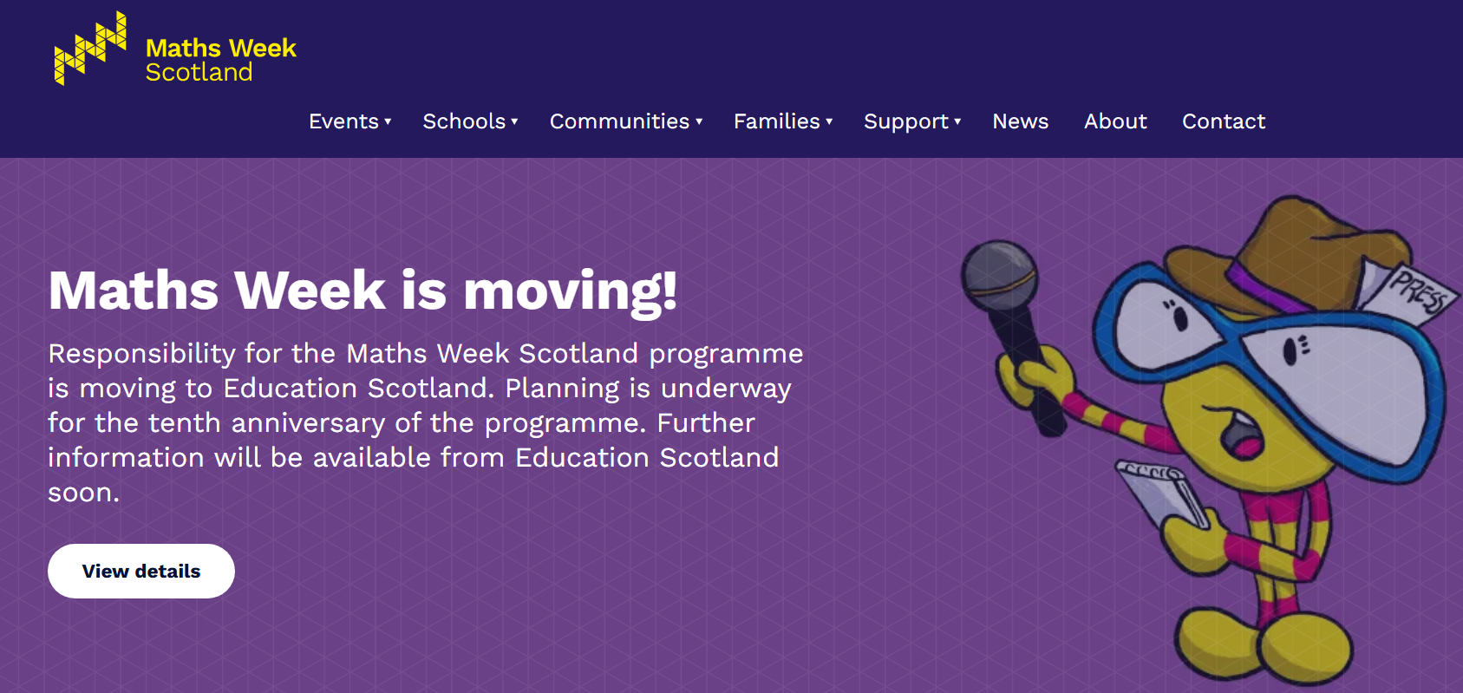
Maths Week Scotland

Slide 5
Post-Multiply Picture
Deep dive into Multiply in Scotland, Wales, Northern Ireland https://www.gov.uk/government/publications/multiply-deep-dives-scotland-wales-northern-ireland
Multiply Quarterley Reports https://www.gov.uk/government/publications/multiply-local-allocations-quarterly-progress-report

Slide 6
Post Multiply News - England
Multiply has concluded and a more integrated adult-skills + AI-supported tutoring model is emerging. The UK government formally removed Multiply as a standalone programme after it ended in March 2025, and numeracy support is now being absorbed into the broader Adult Skills Fund and local flexible provision. (GOV.UK)

Slide 7
Post Multiply News - England
There has been a shift from basic maths classes to life-and-work numeracy
The strongest trend is away from abstract GCSE-style reteaching and toward functional numeracy in context:
  budgeting and debt
  childcare / helping children with homework
  workplace numeracy (care, construction, retail, hospitality)
  data literacy and spreadsheets
  interpreting statistics and AI outputs
This is increasingly funded as employability or community learning rather than “maths for maths’ sake.” The Adult Skills Fund 2025–26 follows the broad themes of learning for work, wellbeing, parenting, and community outcomes. (GOV.UK)

Slide 8
Post Multiply News - England
There is some movement from maths attainment to number confidence
A major insight from adult numeracy research is that many adults’ main barrier is identity, not content: “I’m just bad at maths.”
This is why organisations like National Numeracy have pushed “number confidence” frameworks, low-stakes diagnostics, and coaching around mindset.

Slide 9

Post Multiply News - England
A new approach to mathematical and data education: an agenda for change
The Royal Society (the independent scientific academy of the UK, dedicated to promoting excellence in science for the benefit of humanity.) has a long history of helping to shape the educational system and landscape through its research and policy work.
In September 2024 it launched a major new report that makes the case for a new approach to mathematical and data education, offering recommendations for system reform which will provide a better mathematical education for everyone, from the everyday needs of citizens to the brilliant academic mathematicians of the future.
Discussions focused on the importance of mathematical and data education for the individual, for the economy and for the good of civic society. A number of key themes from the report were considered:
The role of computational tools and technology in the teaching, learning and assessment of mathematical and data education,
How the presence of maths and data across the curriculum should be acknowledged and supported.
Ways in which pathways might be developed to provide greater choice and how assessments could be adapted to provide learners with recognition of what they know and can do.
royalsociety.org/news-resources/publications/2025/maths-futures-conference/

Slide 10
Post Multiply News - Scotland
Scotland validated community-embedded numeracy, not “return to school maths”
In Scotland the strongest Multiply interventions were:
hyper-local
delivered through trusted community organisations
linked to everyday tasks
low-stigma
often disguised as another activity
Examples included numeracy embedded in:
cooking
budgeting
parenting
employability
health and wellbeing
crafts and hobbies
The approach was informed by the idea that adults engage better through life situations than curriculum labels.

Slide 11
Post Multiply News - Scotland
Numeracy + social inclusion
Adult learning is an anti-poverty and anti-isolation activity and is not just about employability.
That creates strong demand in:
  money and debt numeracy
  household budgeting
  energy bills / tariff comparison
  numeracy for ESOL learners
  parents in SIMD areas
  adults affected by long-term unemployment
This is especially strong in Glasgow, Fife, Falkirk, and Borders-style local authority models. (GOV.UK)

Slide 12

Post Multiply News - Wales
Adult Learning Wales
Adult Learning Wales (ALW) is the national Adult Community Learning (ACL) organisation for Wales, offering a comprehensive curriculum that spans pre-entry learning through to Level four qualifications. Our programmes cover essential skills in literacy, numeracy, digital literacy, and English for Speakers of Other Languages (ESOL), as well as advanced qualifications in areas such as Youth Work, Education and Training, and Counselling. In addition, we provide a wide range of courses that equip learners with practical, hands-on skills in health and safety, handwork, craftwork, and wellbeing, which are directly applicable to both personal and professional settings.
Numeracy Provision

Slide 13
Post Multiply News - Northern Ireland
Research and analysis
Multiply deep dive research: Delivering adult numeracy skills in Northern Ireland
Published 3 December 2025

Slide 14
Post Multiply News - Northern Ireland
Key findings
Effective partnership working
Strong partnerships and networks were crucial for successful design and delivery of Multiply in Northern Ireland. Collaboration between the Department for the Economy, local councils, the Further and Higher education sectors as well as local community organisations supported a shared understanding of Multiply requirements. This approach facilitated the sharing of ideas and learnings, enhancing innovation as well as aiding problem solving and reducing duplication.
Flexibility in programme delivery and design
The flexibilities offered by Multiply enabled delivery partners to develop initiatives that addressed local circumstances. Consequently, new approaches to numeracy skills training were developed and delivered at pace. Flexibilities including reprofiling spend and modifying content or delivery mechanisms ensured that feedback was acted on and learners’ needs were met.
Understanding local needs and what works
Understanding the specific needs and preferences of local learners ensured that initiatives were relevant and engaging. Practical considerations like venues, timing, and course structure made the programs more accessible and effective. Tailoring initiatives to local contexts, including making maths relatable and fun, contributed to the success of Multiply.

Slide 15
Post Multiply News - Northern Ireland
Key findings
Understand the problem and develop novel solutions
Maths anxiety and limited functional maths skills are a real challenge for individuals, even amongst those who have achieved a level 2 certification. Hiding the maths, or ‘maths by stealth’ helped to engage learners without overtly focusing on numeracy. Creative and fun initiatives like arts and crafts, DIY, and cooking classes made learning enjoyable and removed the stigma of being identified as poor at maths.
Address sustainability at the outset
To ensure a positive legacy for Multiply, beyond the one-year delivery window, a number of initiatives were developed to have a lasting impact on numeracy skills in Northern Ireland. These included professional development for FE tutors, teacher training sessions and supporting resources and ongoing public access to free resources. These resources and new pedagogies will remain active beyond the funding period.
The value of community engagement
Where and how initiatives are delivered impacts their effectiveness; community-based delivery was a key factor in the success of Multiply. Delivering sessions in familiar and accessible community settings helped reduced barriers to engagement and improve delivery partners’ understanding of learners’ needs.
Additional outcomes
Multiply has had an impact beyond numeracy skills. For many participants, attending an activity helped build their confidence, improve their well-being and for some was the very first steps in engagement with wider learning and towards employment. It is important to capture these additional outcomes or secondary consequences to ensure understanding of the impact of any programme.

Slide 16
Ireland
NALA
NALA help people improve their literacy and numeracy and they:
advocate for and empower adults with unmet literacy needs and those organisations and professionals working with and supporting those adults;
enable organisations to be literacy friendly in the development and delivery of their services
Since 2000, NALA has been using television, radio, print, telephones and the internet to provide educational opportunities to people who want to improve their literacy. We operate a Tutoring Service, providing tutor support over the phone and internet. We also manage an eLearning website www.learnwithnala.ie where people can have their skills assessed across a number of areas and then be prescribed an individual learning plan to improve these areas.
Guide to NALA numeracy resources

Slide 17
Key areas of work linked with numeracy - ESOL
What are your experiences of tutoring numeracy with ESOL learners?
Do you know of any projects looking at Numeracy and ESOL?
Some resources can be found here if you are interested:
  Skillsworkshop

Slide 18
Key areas of work linked with numeracy – Building Racial Literacies
antiracisted.scot
Resources and support for anti-racist education practitioners across Scotland.
This website provides tools, workshops and ideas to support Early Years practitioners and educators in Scotland to build an anti-racist curriculum which responds positively to the diverse needs of individual learning where all cultures, religions, identities and languages are recognised and valued.
The materials have been developed in partnership with a racially diverse group of children, young people and educators across different sectors of Scottish Education.
Anti-racist Toolkit
This toolkit builds upon the work developed and delivered by Education Scotland through their Building Racial Literacy (BRL) programme. This space was developed in response to a growing need among CLD workers who want to deepen their understanding of racial justice and actively foster anti-racist practices.

Slide 19
What would you like to see in future Numeracy Network Meetings?
Please contact Jackie Howie at jhowie@learninglinkscotland.org.uk

